Slide 1
U.C. Davis – IET Campus Data Warehouse
2009 Architecture Plan
Overview

Slide 2
The Problem Set
Cumbersome process for obtaining user access
Problematic Data Security
Query Construction is difficult
No record of data use for capacity planning and auditing

Slide 3
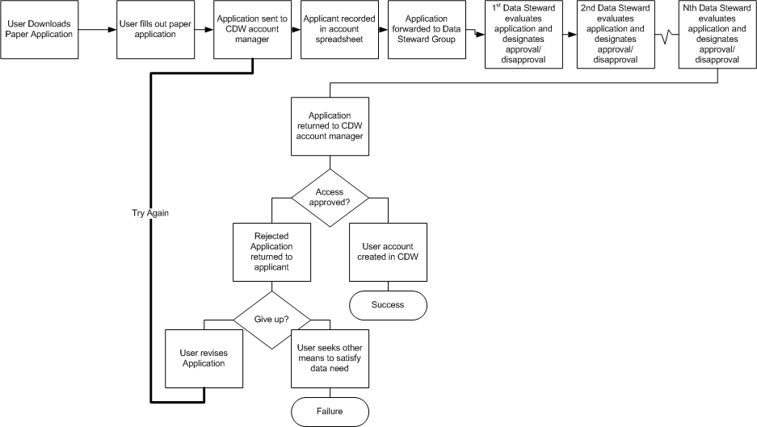
User Access Approval Path
2-8 weeks per decision

Slide 4
Problematic Data Security
Table/view level access permits broader access to data than users require (Invites inappropriate usage)
Entire tables may be copied to user systems
Essential access may be denied because of collateral risks (Essential data in one part of a table may be denied to prevent exposure of sensitive information in a different part)
No record of data requests and usage (who used or tried to use inappropriate data)
The security level of datasets is not formally classified
There is no reliable way to identify users of departmental accounts

Slide 5
Query Construction Issues
Users must understand data encoding and structure to obtain valid results (cryptic codes like ‘AS’ must be used to filter data. Multiple rows of identical keys must be processed carefully to select the correct row)
Improper JOIN conditions may create incorrect results and adversely impact performance
Syntax errors may produce confusing, or even worse, undetected errors that require additional technical support
This is not an exhaustive list

Slide 6
No record of usage
Precludes analysis for capacity planning
Precludes analysis for inappropriate usage
Precludes detection of attempted or actual abuse
Precludes reporting of usage to user management
Abuse or fraud detection
Data product valuation (Hey! We use this a lot, don’t we?)
New application analysis

Slide 7
Information Worker Needs
A desk
A chair
A telephone
A computer
Information (Data needed to perform job)

Slide 8
Information Worker Needs
A desk
A chair
A telephone
A computer
Information (Data needed to perform the work)
Guiding Principle
Information Workers are entitled to all of the tools needed to do the job, especially the data. They don’t need any further justification for access to the data.

Slide 9
2009 CDW Architecture
Data Packaging
3 Tier Architecture
Integral CAS security
Usage Logging
Fine grained access
Automates basic user access
Simplifies restricted user access
Transparent access to foreign systems
Collaborative development protocol

Slide 10
Data Packaging and Classification
Data is provided using packages of functions that return rowsets.
There is no direct user access to tables or views
Each package is classified by the Data Stewards according to the security level of the data it provides:
Private (The database is used to host private data)
Public (Data that is public information)
Confidential (Business data that contains no “Sensitive” information)
Restricted (Contains “Sensitive” information like grades, gender, academic standing…)

Slide 11
3 Tier Architecture
Back end database using Oracle database product
Middle layer implemented in Oracle PL/SQL
User Interface may be anything that can make a SQL call and process a rowset return. (PHP, Cold Fusion, MSAccess, Excel, .net, JSP…)

Slide 12
3 Tier Architecture
Why PL/SQL? (and not SOAP or other web service)
We already own the technology
We understand it
Users already know how to access it
We are able to extend it with Java
We have a PL/SQL 3 tier application in production
We have good, free development tools
Collaborative development requires minimal training

Slide 13
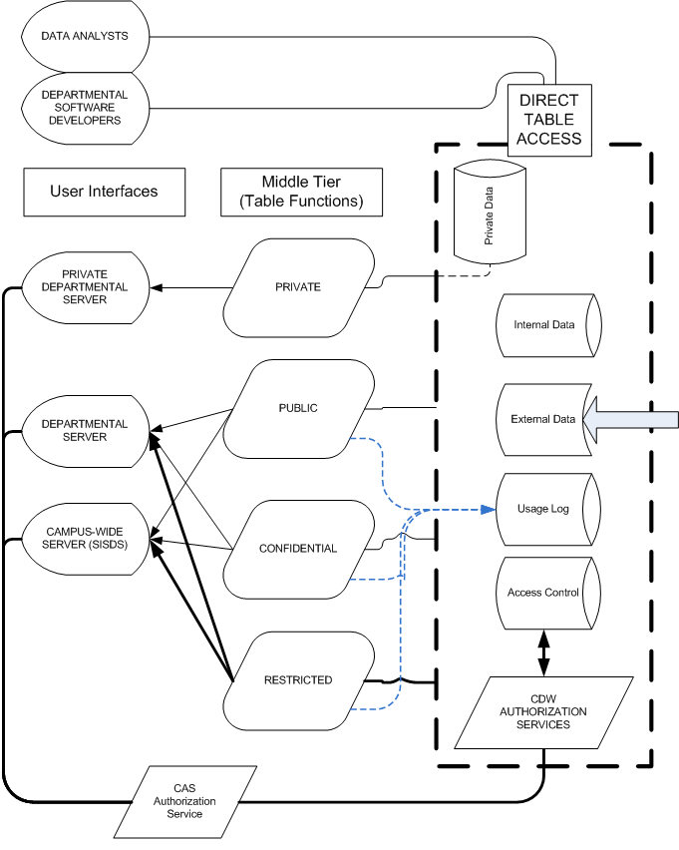
3 Tier Architecture

Slide 14
Integral CAS security
Campus standard single sign on
Proxy ticket provides guaranteed user Kerberos ID for fine grained authentication and usage logging

Slide 15
Integral CAS security

Slide 16
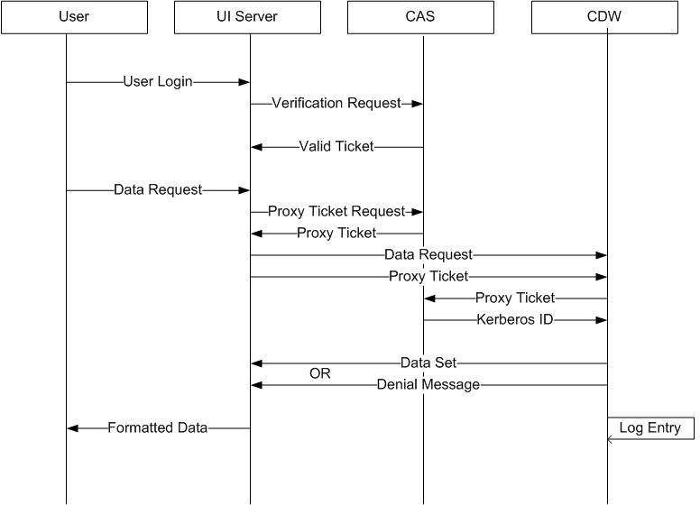
Integral CAS security

Slide 17
Usage Logging
Each data requests captures :
User Kerberos (or eMail) ID
Connection name (typically department account)
Name of package/function
Security classification
Timestamp
Parameters used
Number of rows returned
Success or Failure (reason for failure)

Slide 18
Usage Logging

Slide 19
Fine Grained Access
Restricted data access is controlled by an access table
Table entries are keyed on KerberosID and contain permissions to fetch RESTRICTED data
Rights to RESTRICTED data are authorized by the user’s director/dean/provost
Access grants are reported to data stewards
Access is suspended when the user changes payroll status

Slide 20
Fine Grained Access

Slide 21
Automatic Basic User Access
Individual user accounts to CDW are phased out.
Execution rights to PUBLIC and CONFIDENTIAL packages are granted to departmental accounts.
Any user that has access to a departmental server (or SISDS) is automatically granted access to its departmental level packages.
The Kerberos ID may optionally be checked against employment status to exclude non-employees from designated packages.

Slide 22
Simplified Restricted Access
A director/dean/provost may autonomously grant access to a Restricted package
The director is contractually obligated to bear responsibility for the appropriateness of the access grant
An electronic record of the grant is reported to the Data Stewards, who may direct that access be suspended or revoked
The grant is automatically suspended when employment status changes

Slide 23
Transparent Access To Foreign Systems
The CDW has the capability to serve as a portal to any database in the world
Foreign data may be collected and stored in the CDW for subsequent access
Foreign data may be accessed in real time and returned using the same PL/SQL table function semantics as internal data

Slide 24
Transparent Access to Foreign Systems
Remote Data System via JDBC

Slide 25
Collaborative Development
Departmental collaborator is granted full development rights in CDW development system for the duration of the project
CDW staff provide guidance, standards and implementation of collaboration products
Data analysts may still apply to the Data Stewards for direct table access in order to perform research on the base data

Slide 26
Transparent Access to Foreign Systems
Collaborator Accounts

